Slide 1

PipeWan

Slide 2
Group Members
Aron Wiley, CS – Leader
Edgar Chavez, CS – Facilitator
Alex Rossillon, CS – Scribe
Mohammad Daoud, CE – Timekeeper

Slide 3
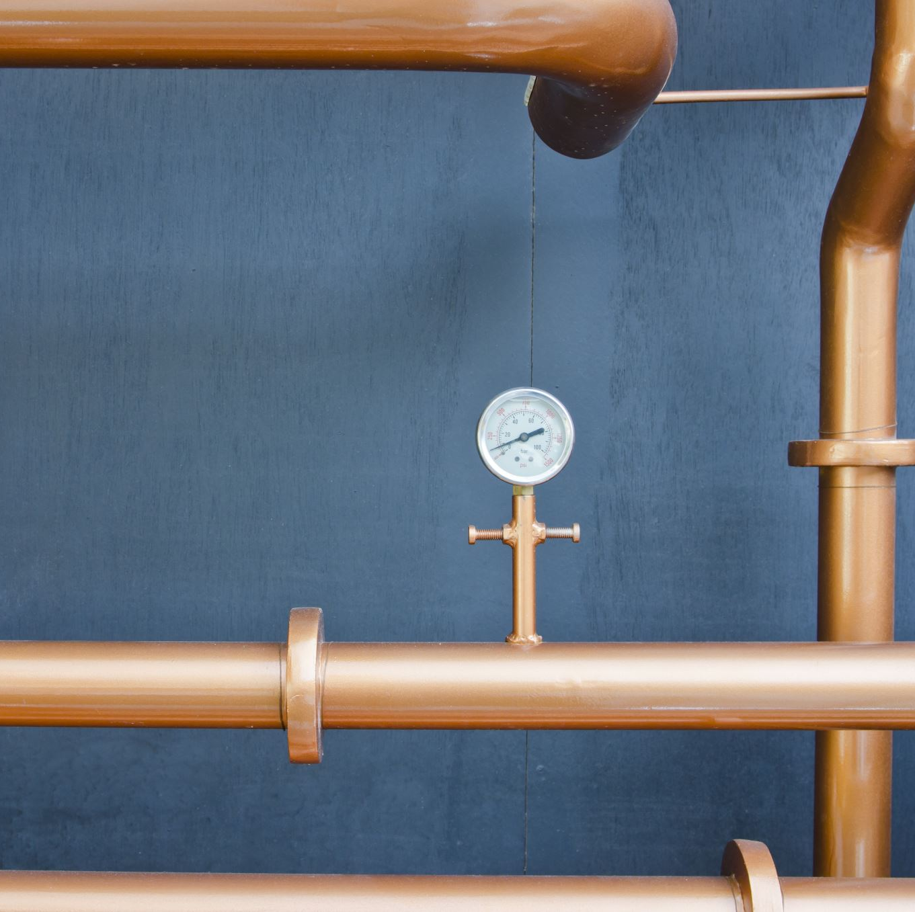
Project Overview (Aron)
Monitor
Our goal is to monitor the temperature and flow rate of water inside pipes
Warn
Give building owners an early warning for errors
Action
Stop pipes from freezing

Slide 4
Summarized Project Requirements (Alex)
Physical
Temperature sensor
Flow sensor
Arduino
Software
Arduino software (w/ LoRaWan library)
LoRaWan specification
Application to warn building owners

Slide 5
Software Development (Alex)
Languages
Arduino: C++
Application: C#
Libraries
Arduino libraries
Environment: VS WPF
Application libraries
LMIC – LoRaWan Arduino library
Any libraries needed for the particular Arduino/ sensors we get
system.net.socket, threading, and many others
MySql.Data.MySqlClient

Slide 6
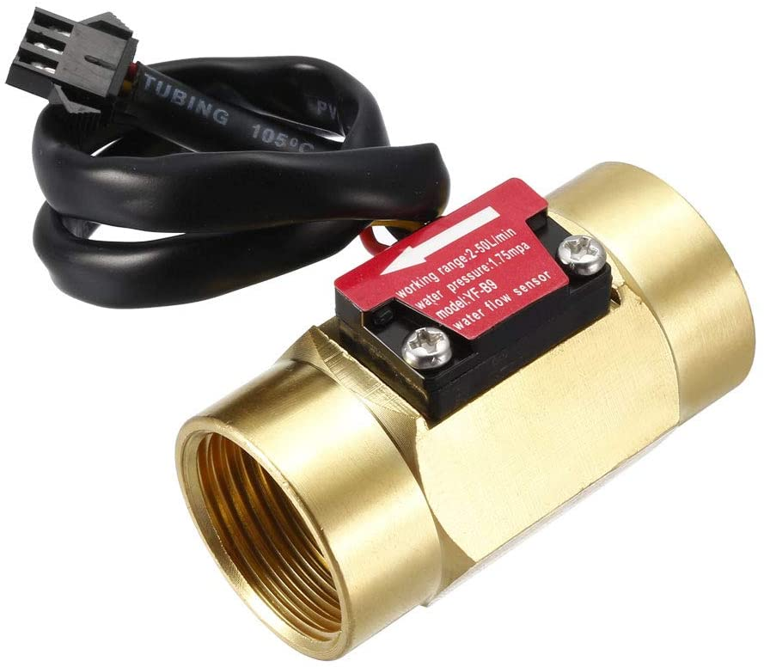
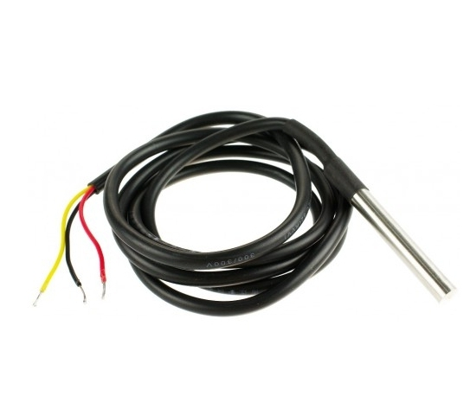
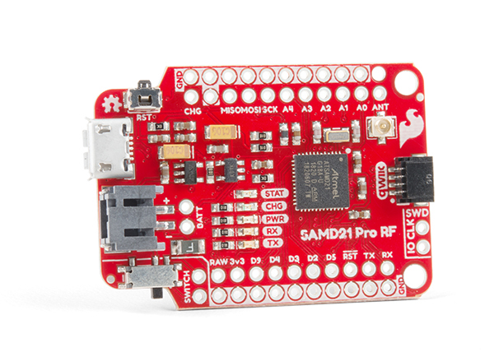
Hardware (Aron)
Arduino
A LoRaWan ready Arduino module
Temperature Sensor
Monitor the temperature of the water inside the pipes
Flow sensor
Monitor the flow of water within pipes
Antenna
Works with US915 MHz band

Slide 7
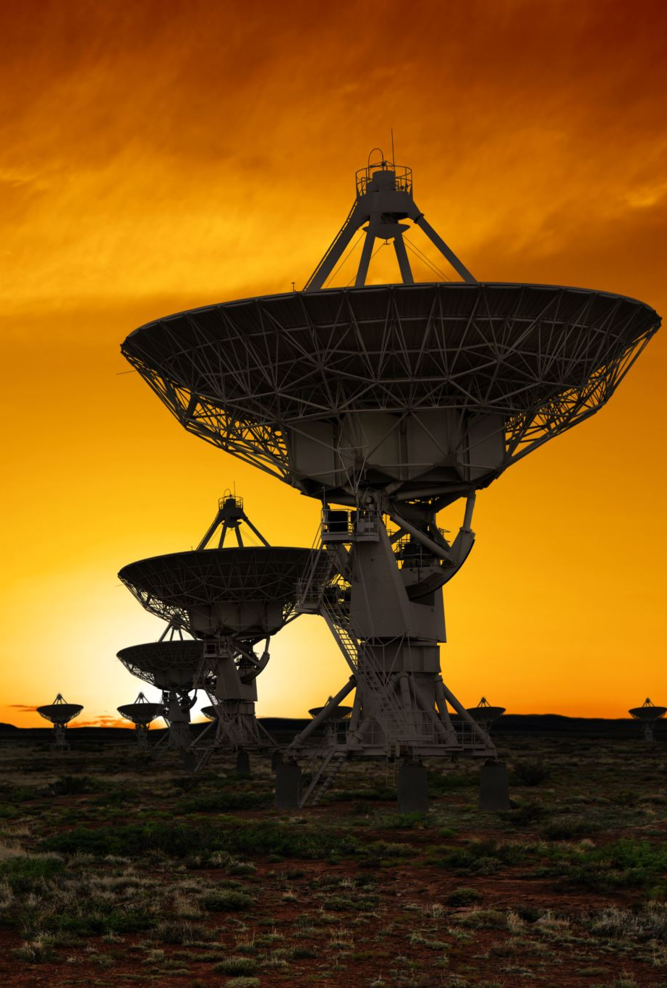
RF Emission standards & Local interference (Moe)
Lora devices send signals on an unlicensed sub-GHz radio spectrum. The Frequency band Range for the US902-928 standard ranges from 902-928 MHz.
Lora utilizes a chirp spread spectrum modulation with centralized frequency of 915 MHz which provides the highest bandwidth and longest range. Around the central frequency modulation of data happens.
Only when another signal with the same bandwidth emitting at the same time following a similar pattern of data interference happens. This means Lora signals are effective in avoiding interference.

Slide 8

RF Emission standards & Local interference (Moe)
Still interference can happen since in the US, Lora operates in an unlicensed band that anyone can use if standards are followed.
RF interference occurs when two or more sources are emitting signals with similar frequencies at the same time.
This can be minimized by only emitting Lora signals in longer time intervals for less time. Or by installing RF filters such as band-pass filters on the signal path.
Band-pass filters limits the bandwidth of the output signal to the specified band. This helps isolate our signals from interfering with others.

Slide 9
Antennae placement and design(Moe)
There are many factors that decide on the effectiveness of the antennae.
Type: Omnidirectional. Gives flexibility and fault tolerance.
Size: An optimal antennae size for the US902-928 standard would be around 8 or 16 cm to fulfill the average signal wavelength of 33 cm.
Location: Higher Elevation to get maximum range and reduce attenuation.
Obstacles: Minimize obstacle distance from transmitting and receiving antennae.
Direction: Vertical for omnidirectional signals, assure synchronization b/w transmitter and receiver.
Material: Good insulation and shielding can optimize signal quality and reduce interference.

Slide 10
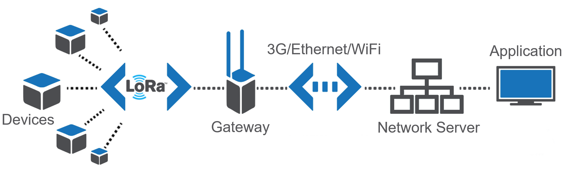
Gateway function (Edgar)
LoRa is used to set up communications between LoRa devices
A gateway serves as a bridge to connect LoRa to any other network becoming LoRaWAN

Slide 11
Network Server function. (Edgar)
Manages the entire LoRaWAN network and is responsible for several functions
Over-The-Air-Activation (OTAA) is a join procedure between the end device and the network server
Message deduplication eliminates duplicate messages received by multiple gateways
Message routing ensures uplink, downlink, etc all go to their appropriate locations

Slide 12
Connecting the node to the server (Aron)
We will connect using OTAA
We will use existing gateway(s)
The Arduino will have the LMIC library running on it to connect to the LoRaWan server

Slide 13

Data Security
Application key is the root key used to derive session keys for AES-128:
Application Session Key (AppSKey)
security through integrity and authenticity
Network Session Key (NwkSKey)
security through confidentiality
New session keys on join or rejoin
AppSKey provides application layer Node -> Gateway -> Server -> Application is AES-128 encrypted
Once the data reaches the Network Server, it can be accessed be the application online through any secure means such as TCP/IP SSL
Join Server (In Network Server)
Handles the sensitive part of the device activation in any LoRaWAN network
Authenticates Network and Application Servers
Stores root keys
Generates session keys
Security Concern
Because LoRaWAN is long range and utilizes an unlicensed spectrum, anyone can monitor the encrypted traffic

Slide 14
Data Management
Once the application receives and interprets the data from the server, it needs to store it
Device address, temperatures, flow rates, battery life
There are many ways to accomplish this
plaintext, xml, json, csv, MySql, SQL Server Express, SQL LocalDB, Access
Not a lot of data to store. Ideally compatible with C# .net
MySql is a free, opensource database management system which supports .net

Slide 15

Questions Comments Concerns

